Slide 1
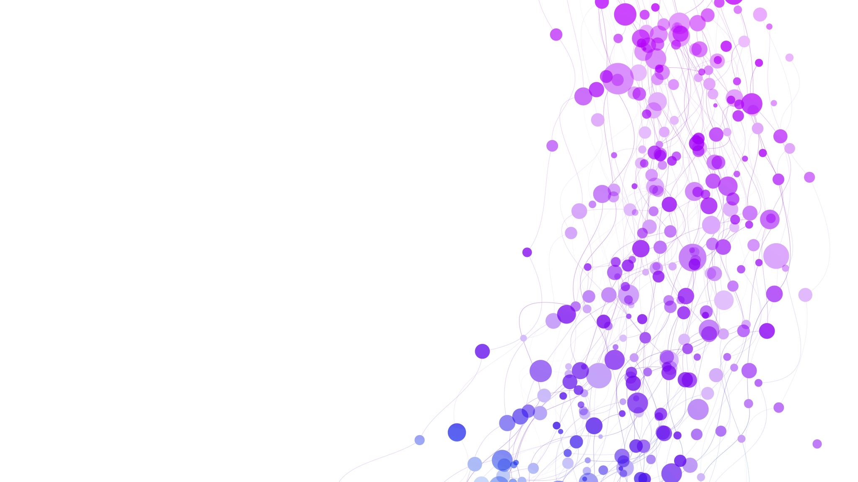
Resilient Distributed Datasets (RDDs) in Apache Spark
Resilient Distributed Datasets (RDDs) in Apache Spark
Team Members :
Jaideep D
Loka Nehan Reddy
JVBS Satwik

Slide 2
Introduction to Apache Spark
Apache Spark is an open-source, distributed computing framework designed for fast and scalable big data processing.
Originally developed at UC Berkeley’s AMPLab, Spark is now one of the most widely used frameworks in the big data ecosystem.
It provides fast , scalable and in-memory data processing.

Slide 3
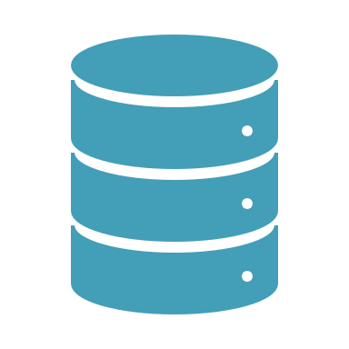
What is an RDD (Resilient Distributed Dataset)? Definition: An RDD is the fundamental data structure in Apache Spark that stores data across multiple machines in a cluster. Enables parallel data processing across multiple nodes. Key Characteristics: 🟢 Immutable & Distributed Data is split into partitions and stored across multiple nodes. Once created, an RDD cannot be modified—new RDDs are derived through transformations. 🟢 Lazy Evaluation Operations are executed only when an action is called. Reduces unnecessary computations, improving efficiency. 🟢 Fault Tolerance Uses lineage (DAG tracking) to recompute lost partitions in case of node failure. No need for data replication like in Hadoop. 🟢 Parallel Processing RDD operations run concurrently on different nodes. In-memory computation boosts performance over disk-based systems.

Slide 4
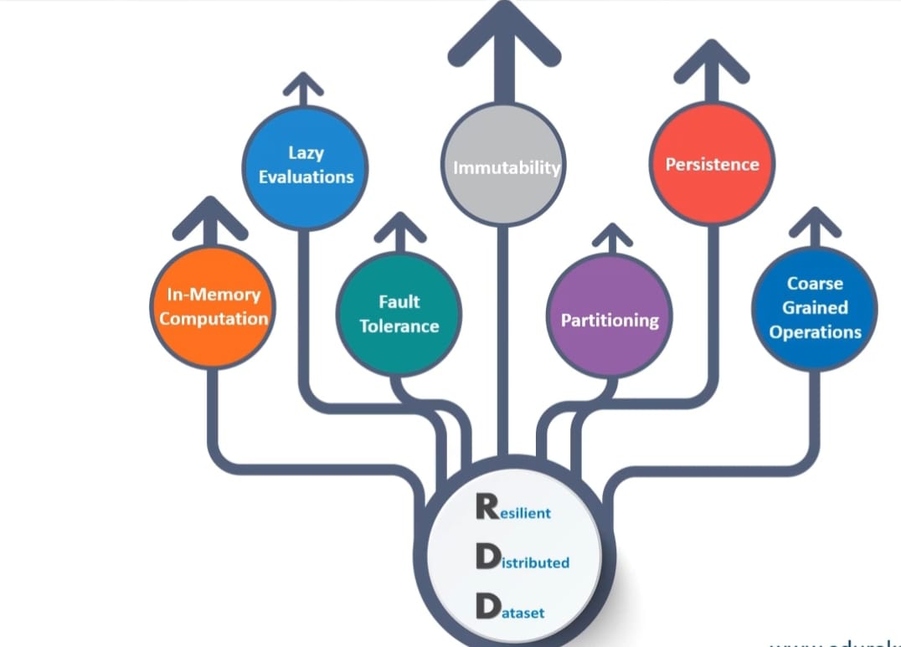
Key Features of RDDs
Resilient: Recovers lost data automatically.
Distributed: Data is split across cluster nodes.
Lazy Evaluation: Optimizes execution by deferring computations.
Immutable: Once created, cannot be modified.
Fault-tolerant: Uses lineage graphs to recompute lost data.

Slide 5
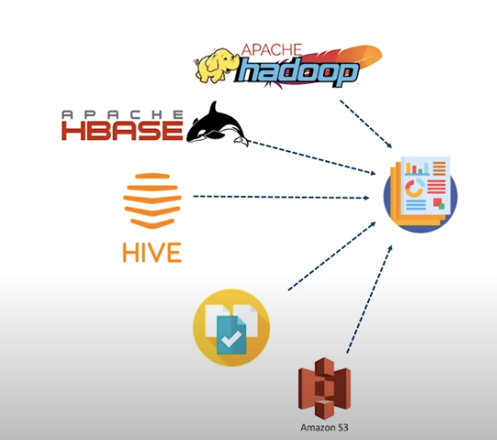
Sources of RDDs
Apache Hadoop – Spark can read data from HDFS (Hadoop Distributed File System), making it compatible with the Hadoop ecosystem.
Apache HBase – A NoSQL database that stores large amounts of sparse data. Spark can integrate with HBase to process its datasets.
Apache Hive – A data warehouse that provides SQL-like querying on Hadoop. Spark can process data stored in Hive tables.
Amazon S3 – A cloud-based storage service used to store and retrieve large datasets, which Spark can process.
Other Data Sources (Relational Databases, Local Files, etc.) – Spark can also create RDDs from structured databases (e.g., MySQL, PostgreSQL) or local file systems.

Slide 6
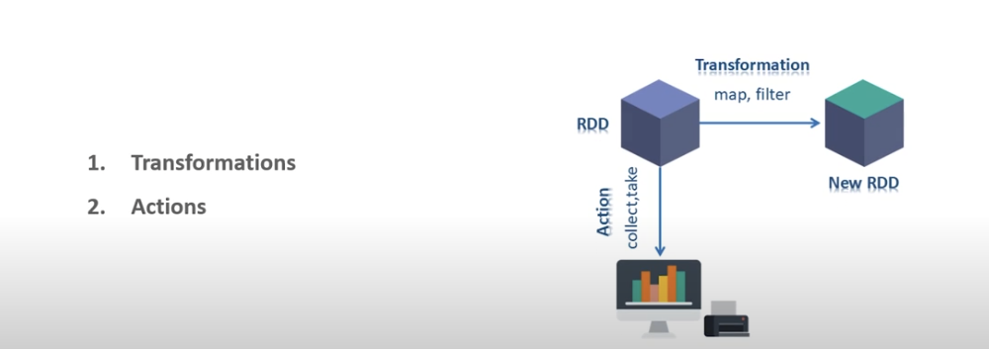
Operations performed on RDDs
Transformations are applied on RDDs to access ,modify and filter the current RDD to generate a new RDD.. The new RDD returns a pointer to the previous RDD to ensure the dependency between them. Two types: 1)Narrow Transformation
2)Wide Transformation

Slide 7
1)Narrow Transformations
Narrow transformations are those where data required for a computation is present within a single partition. These operations do not require data movement across partitions, making them more efficient.
Examples:
map() – Applies a function to each element in the RDD, creating a new RDD with transformed elements.
filter() – Retains only the elements that satisfy a given condition.
flatMap() – Similar to map(), but each element can produce multiple outputs.
partition() – Divides the RDD into a specified number of partitions without shuffling data across nodes.
mapPartitions() – Similar to map(), but processes entire partitions at a time instead of individual elements.

Slide 8
2) Wide Transformations
Wide transformations require data shuffling across partitions, meaning that data from multiple partitions is exchanged across the cluster. These transformations are more expensive in terms of performance as they involve network communication.
Examples:
reduceByKey() – Aggregates values by key across multiple partitions, requiring data shuffling.
union() – Combines two RDDs, possibly requiring data movement if partitions do not align properly. Actions in RDDs
Actions in Apache Spark are operations that trigger computation and return results to the driver program. Unlike transformations (which are lazy and create new RDDs), actions execute the transformations and return a final value or output.
Actions can be categorized into basic and aggregate actions based on their purpose.

Slide 9
1) Basic Actions
Basic actions retrieve or interact with data but do not perform aggregation.
Examples:
collect() – Returns all elements of the RDD to the driver program as a list.
count() – Returns the total number of elements in the RDD.
first() – Fetches the first element from the RDD.
take(n) – Returns the first n elements from the RDD.
foreach() – Applies a function to each element in the RDD, typically used for logging or writing output.
2) Aggregate Actions
Aggregate actions compute a result from the entire dataset using a function.
Examples:
reduce() – Aggregates elements of the RDD using an associative function (e.g., summing values).
fold() – Similar to reduce(), but with an initial zero value that ensures consistency.
aggregate() – Performs aggregation with separate operations for merging within partitions and across partitions.
countByKey() – Counts the occurrences of each key in an RDD of key-value pairs.

Slide 10

What is a Data Frame in Spark?
A Data Frame in Apache Spark is a distributed collection of data organized into named columns. It is similar to:
Tables in relational databases (SQL)
Data Frames in Pandas (Python) and R
Key Features of Data Frames
Schema-based – Data is stored in a structured format with column names and types.
Optimized for Performance – Uses Catalyst Optimizer for query optimization.
Distributed – Data is spread across a cluster for parallel processing.
Interoperable – Supports Spark SQL API and works with multiple data sources (CSV, JSON, Parquet, databases).

Slide 11
Key Differences Between RDDs and DataFrames
Feature RDDs Data Frames
Structure Unstructured Tabular (Columns & Rows)
Performance Slower Optimized (Catalyst Optimizer)
Operations Low-level API High-level API (SQL & Functions)
Storage Java/Python objects Efficient storage in Tungsten format
Optimization No optimization Uses Catalyst & Tungsten optimization

Slide 12
Conclusion
"In conclusion, Resilient Distributed Datasets (RDDs) are the backbone of Apache Spark, enabling efficient distributed data processing. They offer immutability, fault tolerance, and parallel execution, making them a powerful tool for handling large-scale data. However, with the introduction of DataFrames, Spark provides an optimized alternative for structured data processing. While RDDs give fine-grained control, DataFrames offer better performance and ease of use. The best approach is to use DataFrames whenever possible and RDDs when specific low-level transformations are required. Understanding these differences allows us to make informed choices while working with big data. Thank you!"

